Slide 1
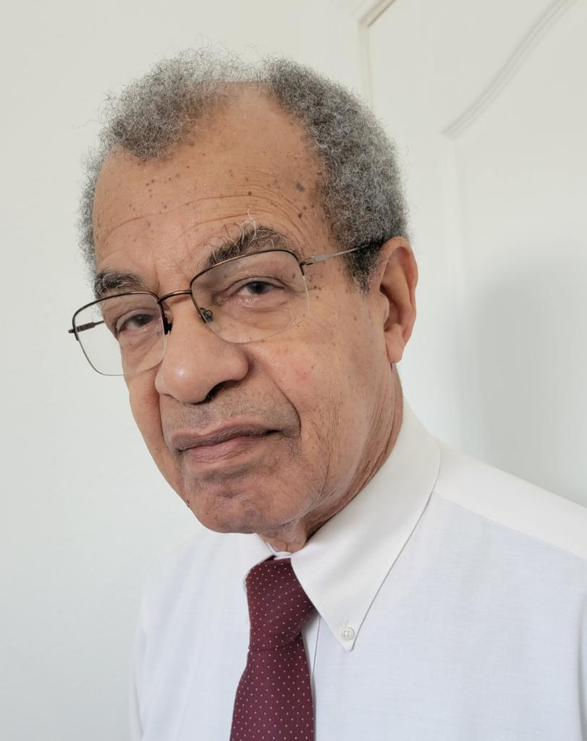
Bro. Mark Grant Wesley Chapel, Florida

Slide 2
I AM
THE
ALPHA
AND
THE
OMEGA

Slide 3
REVELATIONS 1:8
I am the ALPHA and the OMEGA, the Beginning and the End, says the Lord,” who is and who was and who is to come, the Almighty.”

Slide 4
UNDERSTANDING ALPHA & OMEGA
IN THE CONTEXT OF THE BOOK OF THE REVELATION;
IN THE CONTEXT OF THE ENTIRE SCRIPTURES.

Slide 5
THE ALPHA & OMEGA SYMMETRIES
ALPHA AND OMEGA REFERENCES IN REVELATION
GOD THE FATHER AND GOD THE SON;
THE SYNONYMS

Slide 6
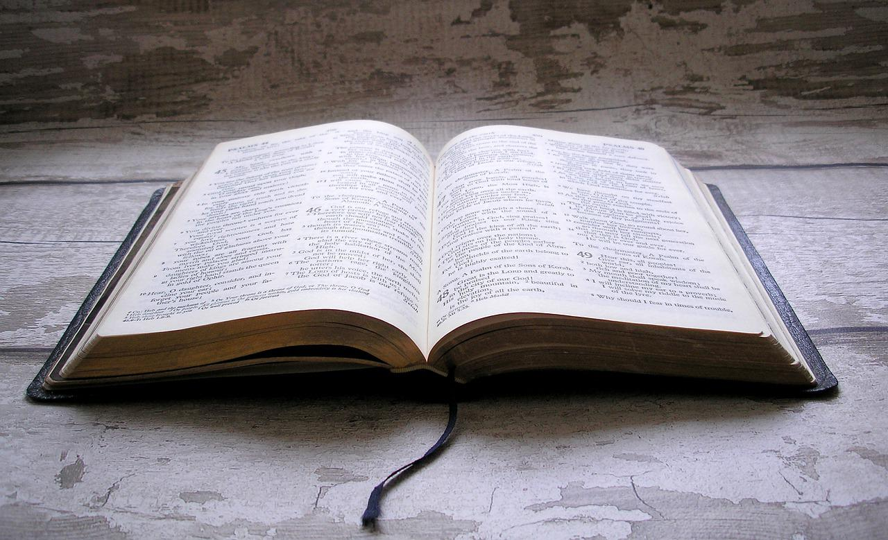
THE REVELATION OF JESUS CHRIST
THE BEGINNING
CHAPTER ONE
FIRST CHAPTER
THE END
CHAPTER 22
LAST CHAPTER

Slide 7
FIRST AND LAST REFERENCES: ALPHA & OMEGA IN REVELATION
REVELATION: THE BEGINNING |  | REVELATION: THE END
“I am the Alpha and the Omega, the Beginning and the End,” says the Lord, “who is and who was and who is to come, the Almighty. Revelation 1:8 |  | I am the Alpha and the Omega, the Beginning and the End, the First and the Last.” Revelation 22:13

Slide 8



GOD THE FATHER AND GOD THE SON
THE FATHER |  | THE SON
“I am the Alpha and the Omega, [d]the Beginning and the End,” says the Lord, “who is and who was and who is to come, the Almighty. Revelation 1:8 |  | “I am the Alpha and the Omega, the First and the Last,” Revelation 1:11
I am the Alpha and the Omega, the Beginning and the End. I will give of the fountain of the water of life freely to him who thirsts. Revelation 21:6 |  | I am the Alpha and the Omega, the Beginning and the End, the First and the Last.” Revelation 22:13

Slide 9
ALPHA AND OMEGA IN THE CONTEXT OF THE REVELATION
THE DESCRIPTIVE SYNONYMS OF THE ALPHA AND THE OMEGA:
THE BEGINNING AND THE END
THE FIRST AND THE LAST

Slide 10
ALPHA & OMEGA SYNONYMS
THE BEGINNING AND THE END (THE FATHER) |  | THE FIRST AND THE LAST (THE SON)
“I am the Alpha and the Omega, the Beginning and the End,” says the Lord, “who is and who was and who is to come, the Almighty. Revelation 1:8 |  | “I am the Alpha and the Omega, the First and the Last,” Revelation 1:11
I am the Alpha and the Omega, the Beginning and the End. I will give of the fountain of the water of life freely to him who thirsts. Revelation 21:6 |  | I am the Alpha and the Omega, the Beginning and the End, the First and the Last.” Revelation 22:13

Slide 11



CONFRONTING SCRIPTURAL CONFLICT
THE FATHER |  | HE SON
“I am the Alpha and the Omega, [d]the Beginning and the End,” says the Lord, “who is and who was and who is to come, the Almighty. Revelation 1:8 |  | “I am the Alpha and the Omega, the First and the Last,” ,Revelation 1:11 And when I saw Him, I fell at His feet as dead. But He laid His right hand on me, saying to me, “Do not be afraid; I am the First and the Last. Revelations 1:17
I am the Alpha and the Omega, the Beginning and the End. I will give of the fountain of the water of life freely to him who thirsts. Revelation 21:6 |  | I am the Alpha and the Omega, the Beginning and the End, the First and the Last.” Revelation 22:13

Slide 12
THE MESSAGE AND MEANING A DECLARATION OF DIVINITY
THE LORD JESUS CHRIST IS GOD!

Slide 13
THE ALPHA AND THE OMEGA
IN THE CONTEXT OF THE SCRIPTURES

Slide 14
IN THE BEGINNING GOD CREATED THE HEAVENS AND THE EARTH.
This Photo by Unknown Author is licensed under CC BY-NC
(HEBREW TEXT IS READ FROM RIGHT TO LEFT.)

Slide 15

ALEPH - TAV
This Photo by Unknown Author is licensed under CC BY-SA-NC
(HEBREW TEXT IS READ FROM RIGHT TO LEFT.)

Slide 16
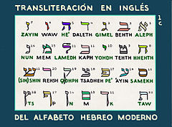
HEBREW ALPHABET (THE ALEPH-BETH)
This Photo by Unknown Author is licensed under CC BY-SA
(HEBREW TEXT IS READ FROM RIGHT TO LEFT.)

Slide 17
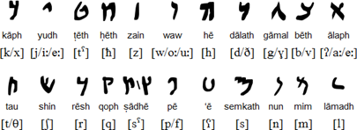
HEBREW ALEPH-BETH
This Photo by Unknown Author is licensed under CC BY-SA
(HEBREW TEXT IS READ FROM RIGHT TO LEFT.)

Slide 18
THE ALPHA AND THE OMEGA IN THE OLD TESTAMENT (ISAIAH’S EXPLICIT REFERENCE)
“Thus says the Lord, the King of Israel, and his Redeemer, the Lord of hosts: ‘I am the First and I am the Last; besides Me there is no God.
Isaiah 44:6

Slide 19
OTHER EXPLICIT REFERENCES IN ISAIAH
‘I, the Lord, am the First; and with the Last I am He.’ ”
Isaiah 41:4b

Slide 20
OTHER EXPLICIT REFERENCES IN ISAIAH
‘I, the Lord, am the First; and with the Last I am He.’ ”
Isaiah 41:4b
I am He, I am the First, I am also the Last.
Isaiah 48:12b

Slide 21
THE FIRST AND THE LAST
I am the First and I am the Last; Besides Me there is no God.
Isaiah 44:6b

Slide 22
ISAIAH’S IMPLICIT REFERENCE TO THE FIRST AND THE LAST
That you may know and believe Me, And understand that I am He. Before Me there was no God formed, Nor shall there be after Me. I, even I, am the Lord, and besides Me there is no savior.
Isaiah 43:10b,11

Slide 23
ISAIAH 41:1 - 48:22
I am YHWH…
Besides me …
no [other] God…
I am He.

